Slide 1

NestPod
Jose Omaña, Andrea Miguel Benavent, Claudia Verona, Frank Dalton, Danah Almekrad, Weisi Wu, Saif Alremeithi, Pedro Velez

Slide 2
TABLE OF CONTENTS
01
02
03
04
OVERVIEW
The Problem, The Solution, Business Strategy, Value Proposition, Competitive Advantage, Product Design
MARKETING PLAN
Market Overview, Competitor Analysis, Segmentation, Buyer Persona, Visibility Plan, 4P’s
OPERATING PLAN
General Operations, Supply Chain, Inventory, Quality & HR, Sales & Customer Service Leadership Team
FINANCIAL ANALYSIS
Statements, Investment Ask

Slide 3
The Problem
Silence
Travelers can't find a quiet place to work and focus
Pain Point 1
Travelers often struggle to find quiet, private, and comfortable spaces for productivity, focus, and rest amid the persistent noise and lack of privacy in busy transportation hubs and urban settings.
Privacy
Pain Point 2
Travelers are unable to find options for solitude in crowded spaces
Rest
Travelers have a hard time relaxing in densely populated areas
Pain Point 3

Slide 4
The Solution
Silence
Our soundproof pods offer a serene environment, allowing individuals to regain focus and productivity
Solution 1
Our soundproof comfort pods provide users with a private and tranquil sanctuary, effectively resolving the challenges of noise, lack of privacy, and the quest for peaceful relaxation in the chaotic and stressful airport setting.
Privacy
Users find privacy in a fully enclosed space shielding them from prying eyes and ears in crowded environments.
Solution 2
Rest
Travelers seeking respite from the chaos of airports find a peaceful haven where they can rest.
Solution 3

Slide 5
Business Strategy
Partnerships and Alliances
We are joining forces with airports, airlines, and credit card companies to boost brand awareness, provide brand credibility, and create customer reward options.
Cost Leadership
The price of our pods is lower than other travel pod options and provides a competitive alternative to lounges, restaurants, and workspaces.
Product Differentiation
Our pods offer versatility and convenience that fills in the gap between sleeping pods and lounge areas by bringing silence, privacy, and relaxation together.

Slide 6
Value Proposition
"At NestPod, we offer the perfect sanctuary for modern travelers and professionals seeking peace, privacy, and productivity. With our affordable pricing options, you can escape the noise and distractions of shared spaces, stepping into a private, soundproofed world designed for your comfort. Immerse yourself in quiet, focus on your work, hold confidential meetings, or simply relax in a pristine and hygienic environment. Our commitment to privacy, silence, and cleanliness ensures that your experience is unparalleled, providing a haven for all your needs in the bustling world outside."

Slide 7
Affordability
Privacy
Quiet
Cleanliness
Competitive Advantage
Privacy is at the core of our value proposition. Our soundproof pods provide a completely private and enclosed space, shielding users from external distractions and prying eyes. We've invested in top-notch soundproofing technology and interior design to ensure that users can enjoy confidential conversations, focused work, or restful relaxation in a secure and private setting.
Our competitive advantage in pricing lies in offering affordable access to our quiet pods. We provide various pricing options, including hourly rates and monthly memberships, ensuring flexibility and cost-effectiveness for our customers. By keeping our rates competitive, we make our pods accessible to a broad audience without compromising on quality.
Cleanliness and hygiene are paramount in our service. We maintain stringent cleaning and sanitation protocols, ensuring that each pod is thoroughly cleaned and sanitized between users. Our dedication to cleanliness provides peace of mind to customers, particularly in today's health-conscious climate, allowing them to enjoy a pristine and worry-free experience.
Our commitment to silence and tranquility sets us apart. Our pods are meticulously designed with advanced soundproofing materials and technology, creating an oasis of quiet in the midst of noisy environments. Users can escape the chaos and find peace and concentration within our pods, making them ideal for work, meetings, or peaceful relaxation.

Slide 8
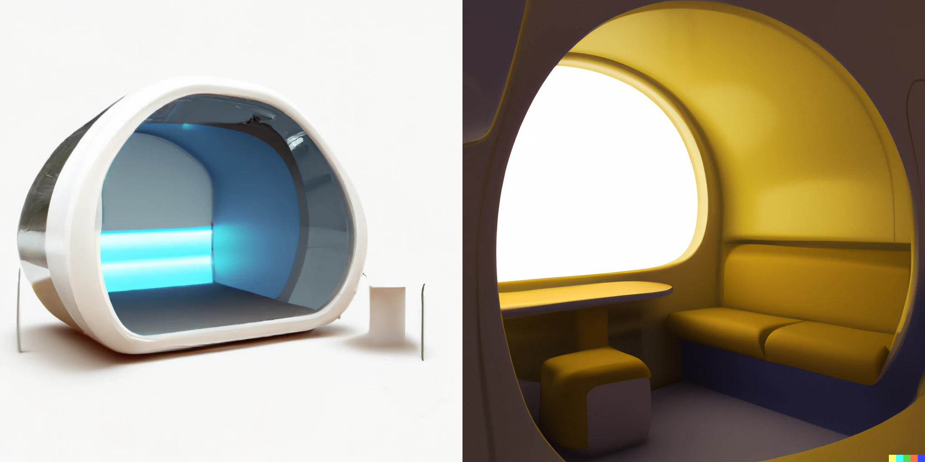
NestPod Design
Features:
Sound proof
Reclining Chair
Desk Space
Plugs
Sanitation Sprayers
Design:
Ergodynamic
Functional
Visually appealing
Ample light

Slide 9
Marketing Plan

Slide 10
Market Overview
WHAT DO WE EXPECT?
In 2022, there were approximately 460 million business travelers and over 900 million tourists on foreign trips.
Post-pandemic travel restrictions, there was a significant increase in international travel, creating a demand for rest options and private spaces.
Flight delays, with an average of 30,000 daily globally, motivate travelers to seek sleeping pod solutions.
TRAVEL INDUSTRY OVERVIEW
Innovations enhancing passenger services are projected to boost market revenue.
The demand for high-end airport services is on the rise, leading to opportunities for market growth.
Smart airports with passenger-friendly services are expected to expand, driven by public acceptance.
FUTURE TRENDS
2022: USD 73.69 million market value
2030: USD 134.28 million market value
Source: Future Market Insights

Slide 11
Competitors
Lounges
Restaurant Areas
Free Work Spaces
Premade Work Boxes
78% or the surveyees access these spaces for the food and 68% gained access in order to make use of leisure amenities.
The average cost is $25 to $60 per person.
Cater to travelers basic needs and comfort while awaiting their flight.
Customers have to buy food to use the tables. They are loud areas.
Areas near boarding gates with seating and usually areas to charge any electronics.
Most of the free areas are deteriorated and crowded.
Some offices utilize work boxes for their employees to be able to get work done quietly in a busy or loud office setting.
They are made for office settings which they are not made to block the noise from an airport

Slide 12
Focus on frequent travelers and business professionals who are looking for a quiet space to work/relax
Segmentation
Geographic
+10M Passenger/year Airports:
Focus on airports with a high volume of national and international flights located in major cities with diverse passenger profiles.
Atlanta
Dallas
Denver
Demographic
Age Groups:
Late 20s to late 50s.
Income Levels:
Individuals with disposable income to spend making from 100k to 350k/year.
Psychographic
Business Travelers: Travelers who need a quiet space and clean space to work
Leisure Travelers:
Travelers who want a comfortable, convenient, and a stress-free experience.
Behavioral
Frequency of Travel: Travelers who fly constantly.
Brand Loyalty:
Create a clean and comfortable experience which will allow customers to keep using the pods (loyalty programs).

Slide 13
Buyer Persona
Bio: Evelyn (38 years old) is on a business trip from BCG. She has a three hour layover and needs some space to take a meeting but she can not find a quiet space to start her zoom call with her team since the airport is very crowded. Has an American Express.
Demographics: Early 30s to early 50s
Education Level: Graduate
Income: $250K- $350K
Psychographic: Career focused, enjoy quiet and zen spaces
Behavioral: people with fast pace working environment like a consultant
Motivation: Wants to get promoted and become Vice president
Pain points: Need to get work done in private spaces without getting into a restaurant or coffee shop
Bio: Brian is an MBA student from a top-lead school. He is traveling home for Christmas but still needs to finish and submit some assignments and exams. He needs a quiet space with good wifi to finish all his assignments. Has an American Airlines Credit Card.
Demographics: late 20s late 30s
Education Level: MBA or PHD
Income: $110K- $200K
Psychographic: Needs calm space to unwind and relax since he struggles with anxiety
Behavioral: People in need of doing job interviews or presentations
Motivation: To graduate and travel to all around the world before he finds a job as an Analyst
Pain Points: Needs an isolated space to get away from crowds and reduce his travel stress

Slide 14
Be always present in the customer's mind by having presence at various spots on the airport and on social media.
Loyalty
Targeting
Partnerships
Expansion
Visibility
Use pay-per-click advertising on Google Ads to target relevant keywords and reach travelers searching for airport amenities.
Run social media advertising campaigns to promote our work/rest station using location to target users located in that airport.
Email marketing, presence on airport billboards and ads on airport wifi login to create brand awareness.
Create a loyalty program that rewards frequent users with discounts, free hours, or exclusive access to premium features.
Offer referral bonuses to incentivize customers to recommend your service to others.
Establish partnerships with airlines, airport authorities, and travel agencies for cross-promotion and referrals.
Offer special packages or discounts in collaboration with nearby hotels or restaurants.
Expand our count of pods on established airports by 10 per year and add one new airport per year for the first 5 years.
Gather customer feedback to improve cleanliness, usability and product design.

Slide 15
Marketing 4Ps
Price
The cost of the working pod is around $15 per hour which aligns with the target market’s willingness to pay.
We are offering a monthly membership price of $49.99 per month with a three month commitment.
Promotion
It is carried out through various channels: the airport's website, social media, and collaboration with airlines and online travel agencies to promote the service. Airport signage and in-terminal advertising.
Place
It will be strategically placed within the airport. Near departure gates, business lounges, and/or high-traffic areas. The convenience of access is crucial.
Product
It provides travelers with private, quiet, and calm space. The pod is made with recycled materials. Offers wifi, travel alerts, and sanitation.

Slide 16
Operating Plan

Slide 17
General Operations
In addition specific costs, we also have general operating expenses.
Rent for our business location
Utilities (electricity, internet)
Marketing and advertising expenses
Insurance (liability, worker's compensation)
Taxes and permits
Office supplies and equipment
Payroll costs (salaries and payroll taxes)
Notes:
Our startup company sells quiet pods to U.S. airports with a high volume of flight traffic. The company has eight employees and it is headquartered in Houston, Texas. The manufacturing partner is a Chinese factory that ships our product by sea.
Rent for our business location
Annual rent for office space in Houston, Texas: $48,000 (approx. $4,000 per month)
Utilities (electricity, water, internet)
Annual utility expenses: $6,000 (approx. $500 per month)
Marketing and advertising expenses
Annual marketing and advertising budget: $24,000 (approx. $2,000 per month)
Insurance (liability, worker's compensation)
Annual insurance premium: $12,000 (this can vary based on coverage)
Taxes and permits
Estimated annual taxes and permits: $10,000 (actual costs may vary based on business size and location)
Office supplies and equipment
Estimated annual office supplies and equipment expenses: $5,000
Payroll costs (salaries and payroll taxes):
Total annual payroll expenses for eight employees (salaries and payroll taxes): $480,000 (this will vary depending on the specific roles and compensation packages for your employees.)

Slide 18
Supply Chain Management
Houston
Warehouse & Operations Facility
Manufacturing is outsourced to China, to incur in lesser production costs to the ones expected in the US. This involves assembling the different parts of the sleeping pods, integrating any electronic components or technologies, and ensuring that each pod meets the company's quality standards and specifications.
Suppliers
Manufacturing contractors

Slide 19
Inventory Control
Maintaining the right level of inventory is essential to meet customer demand while avoiding overstocking or understocking issues.
A balanced supply of 10 pods the first year, to meet customer demand without overstocking or understocking. Our company carefully tracks product movement to and forecasts 10 additional pods to meet demand with optimal production and distribution.

Slide 20

Product Quality Assurance
a. Pods
Initial purchase of 10 units.
Ongoing maintenance and cleaning.
b. Quality Control Measures (Identify & Report)
Yearly quality inspections at airports with maintenance schedules.
c. Quality Assurance Team
Airport cleaning staff to manage quality assurance.
Develop quality control protocols.
Conduct spot checks and customer feedback analysis.
HR Management Efficiency
a. Employee Salaries & Benefits
No salaries the first three years, but there’s equity for 8 shareholders.
b. HR Software and Systems
Invest in HR software for scheduling, payroll, and performance evaluations if there’s an expansion and new hirees in the future.

Slide 21
Sales & Customer Service
a. Customer Understanding
Train sales teams to understand customer needs.
b. Effective Sales Strategy
Target customers are major airports with lots of traffic. Primarily Atlanta Hartsfield or Dallas-Fort Worth.
c. Building Relationships
Encourage relationship-building with airport authorities and travelers.
After-Sales Support
a. Warranty & Repair Services
Offer warranties and a process for repairs.
Encourage online warranty registration for efficient tracking.
b. Service Hotline
A channel for reporting issues and requesting support.
c. Service Network
Establish service repairs if needed in major airports for quick repairs.
A major repair or overhaul would incur in costs for a new one.
d. Customer Education
Develop user manuals and online resources for self-troubleshooting.

Slide 22
Leadership Team
Frank Dalton
Claudia Verona
Jose Omaña
Danah Almekrad
Chief Executive Officer
VP Sales & Marketing
VP Sales & Marketing
VP Sales & Marketing
Weisi Wu
Saif Alremeithi
Andrea Miguel
Pedro Velez
VP Finance
VP Finance
VP Operations & Supply Chain
VP Operations & Supply Chain

Slide 23
Financial Analysis

Slide 24
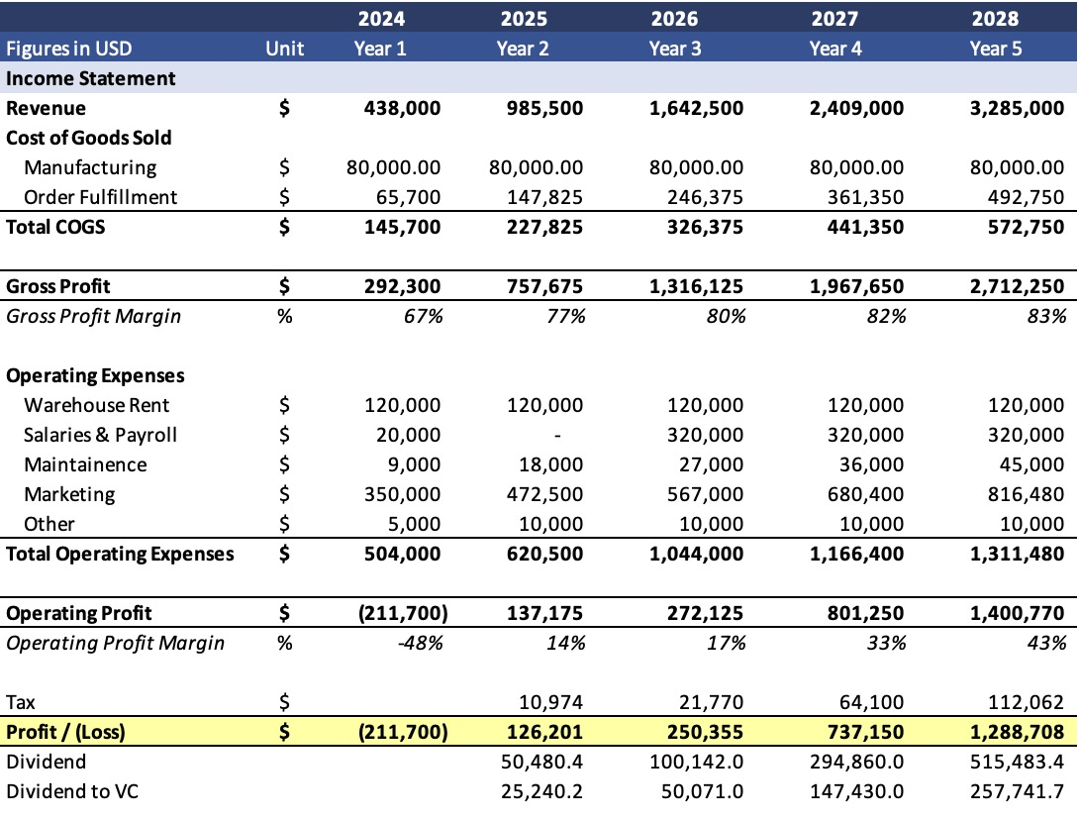
Statements
Revenue growth at a CAGR of 49.6% from 438K to 3.28M forecasted year one to year five
Profits at $126,201 at year two
Gross profit margin increases at a steady rate from 67% year one to 83% year 5

Slide 25
Investment Ask
$400,000
To support growth of five years
Yearly dividends of 20%

Slide 26
References
https://www.aviationpros.com/airports/press-release/21292487/airport-lounge-development-airport-dimensions-data-shows-increasing-importance-of-the-lounge-as-a-new-epicentre-of-airport-commerce
https://www.asdreports.com/market-research-report-625704/global-airport-sleeping-pods-market-global-industry-size-share-trends
https://www.futuremarketinsights.com/reports/airport-sleeping-pods-market
https://www.bts.gov/newsroom/february-2023-us-airline-traffic-data
https://www.trondent.com/business-travel-statistics/

